Slide 1


IEEE SPAWC 2020
Capacity Improvement in Wideband Reconfigurable Intelligent Surface-Aided Cell-Free Network
Zijian Zhang and Linglong Dai
Department of Electronic Engineering
Tsinghua University
May 14, 2020
Notes:
Good afternoon，everyone! My name is Zijian Zhang, from Tsinghua University. It’s my great honor to be here to share the recent application of Reconfigurable Intelligent Surface in wireless communications. Today, I will talk about one of our papers: Capacity Improvement in Wideband Reconfigurable Intelligent Surface-Aided Cell-Free Network.

Slide 2
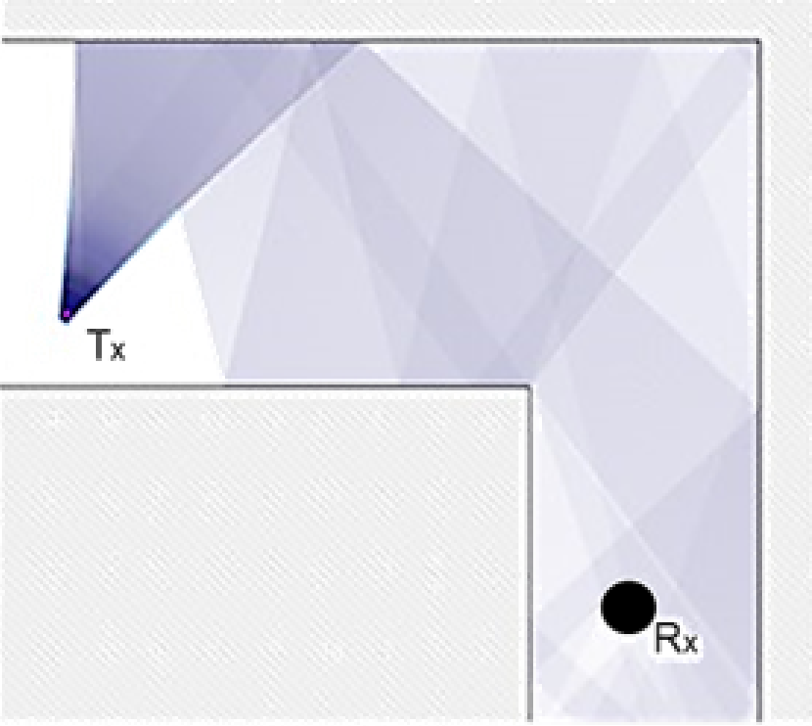
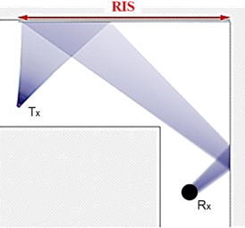
Reconfigurable Intelligent Surface (RIS)
  A surface of reconfigurable metamaterial
  Intelligently control the propagation of electromagnetic wave
  Manipulate the channel to improve the quality of the signal
RIS
Traditional wireless communications:
Heavily rely on the environment
RIS-aided wireless communications:
Intelligently control the environment
RIS is able to change the channel environment!
[Basar’19] E. Basar, M. Di Renzo, J. De Rosny, M. Debbah, M. Alouini, and R. Zhang, “Wireless communications through reconfigurable
intelligent surfaces,” IEEE Access, vol. 7, pp. 116753-116773, Jul. 2019.
Notes:
What is RIS? Its name is reconfigurable intelligent surface (RIS), which is regarded as an emerging new technology for the future 6G. RIS is a surface composed of many reconfigurable elements that made of metamaterial. The elements of RIS are able to reflect the incident electromagnetic wave, and intelligently control the propagation of the electromagnetic wave by changing the phases on all RIS elements, in this way, as shown in this picture, the receiver signal quality can be significantly improved. Different from conventional wireless communications where the channel environment between the base station and user is considered as uncontrollable, the RIS enables us to change the wireless channel in a preferred way. Thus, RIS is able to change the channel environment!

Slide 3
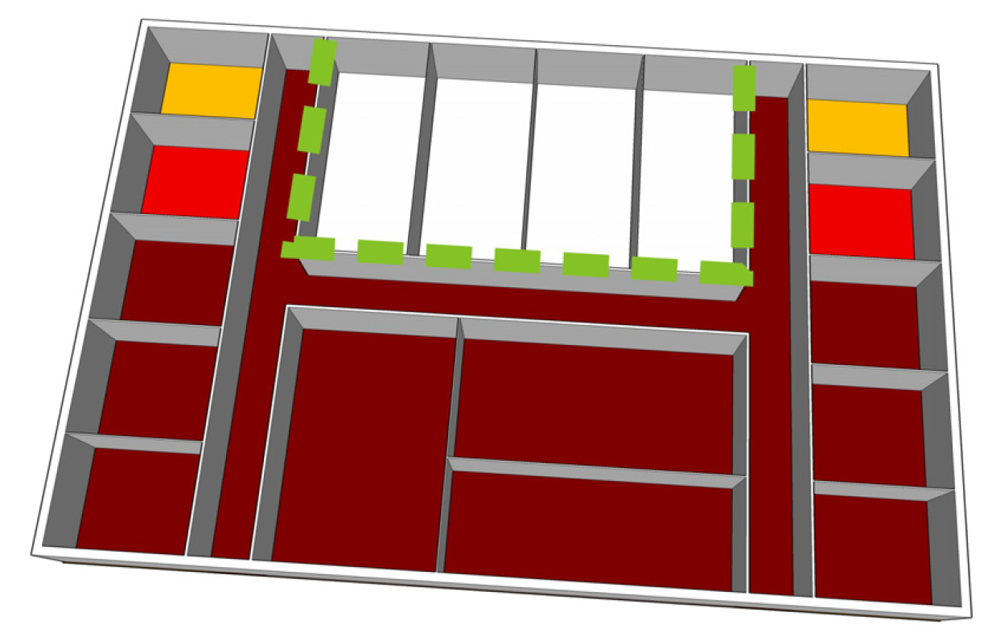

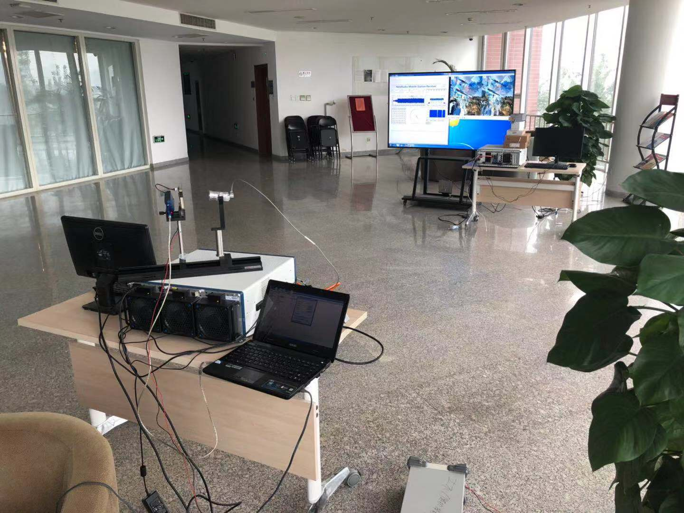
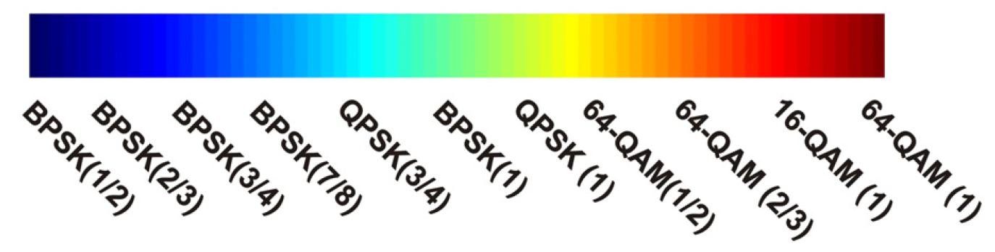
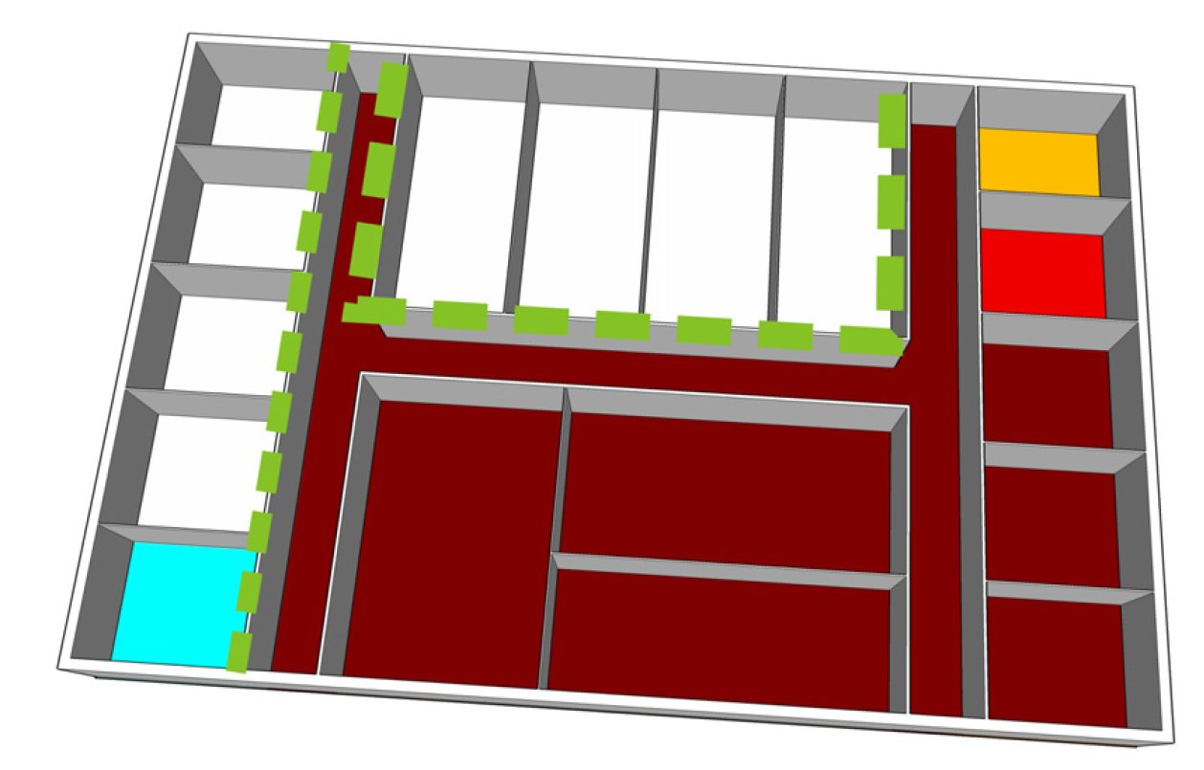
Development of RIS
RIS-based communication systems
Metamaterial
Intelligent walls
Yu’11
Subrt’12
Dai’19
[Yu’11] N. F. Yu, P. Genevet, M. A. Kats, F. Aieta, J.-P. Tetienne, F. Capasso, and Z. Gaburro, “Light propagation with phase discontinuities:
Generalized laws of reflection and refraction,” Science, 334(6054), pp. 333–337, Oct. 2011.
[Subrt’12] L. Subrt and P. Pechac, “Controlling propagation environments using intelligent walls,” in Proc. 2012 6th European Conf. Antennas
Propag. (EUCAP), Prague, Czech Republic, Mar. 2012, pp. 1–5.
[Dai’19] L. Dai, X. Y. B. Wang, M. Wang, J. Tan, S. Bi, S. Xu, F. Yang, et. al, “Reconfigurable intelligent surface-based wireless communication: Antenna design, prototyping and experimental results,” arXiv preprint arXiv: 1912.03620, Dec. 2019.
Notes:
The earliest concept of RIS dates back to 2012, where some researchers propose to deploy some controllable materials on the walls, to control its transparency to the electromagnetic waves. So the signal strength inside the meeting rooms can be intelligently controlled. Recently, our lab has constructed an RIS-based communication system.

Slide 4

Possible Applications of RIS
  Overcome the blockage
  Enhance the signal quality
  Save the power consumption
  Reduce the radiation pollution
One of the promising technologies for 6G
[Zhao’19] J. Zhao and Y. Liu, “A Survey of Intelligent Reflecting Surfaces (IRSs): Towards 6G Wireless Communication Networks,” arXiv
preprint arXiv:1905.00152, Jun. 2019.
Notes:
RIS can be mainly used for the following applications. First, RIS is able to overcome the blockage of the LoS path, particularly for mmWave and THz communications. Second, RIS is able to improve the channel quality, and thus improve the signal quality. Thirdly, RIS can be deployed at the based station to reduce the cost and power consumption, which is particularly important for massive MIMO. Moreover, RIS can reduce the radiation pollution in a specific region like in the hospital or on a plane. Thus, some people believe that RIS is one of the promising technologies for 6G

Slide 5
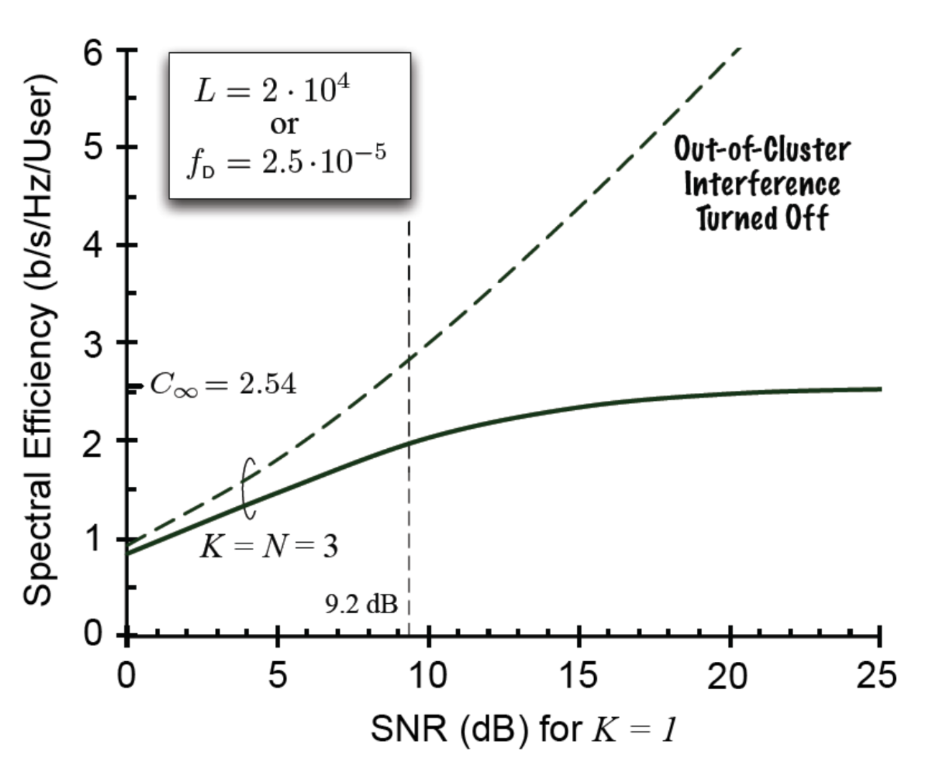


Conventional cellular network
Issue: serious intercell interference^{[Lozano’13]}
intercell interference
用户
基站
^{[Lozano’13]}
With the increasing of cell density, intercell interference becomes the bottleneck of spectrum efficiency
[Lozano’13] A. Lozano, R. W. Heath, and J. G. Andrews, “Fundamental limits of cooperation,” IEEE Transactions on Information Theory, vol. 59, no. 9, pp. 5213–5226, Sep. 2013. (The IEEE Communications Society & Information Theory Society Joint Paper Award)
Notes:
Next following is our moviation.
In conventional cellular network system, the communication cell is divided by cell boundary. In each cell, a base station is deployed to serve for all users (click mouse). While the users is near the cell boundary, they will be interfered by signals from the cells nearby(click mouse). With the coming of 5G, the cell is smaller and denser, which makes the intercell interference issue more and more obvious. In 2013, an article published in TIT, theoretically proved and gave the spectrum-efficiency limit under the cellular architecture (click mouse) . This paper proves that as long as we are still using cellular network architecture, there is a theoretical lower bound that can not be broken due to the intercell interference. This lower bound will rise with the increasing density of the cells, so that when the cell is very small, intercell interference becomes the main bottleneck which limits the spectral efficiency (click mouse)

Slide 6

Challenge of Cell-Free Network
Idea: All BSs serve all users cooperatively^{[Nayebi’15]}
Deploy more power-hungry APs to improve capacity
user
BS
CPU
How to significantly improve capacity with power constraint
[Nayebi’15] E. Nayebi, A. Ashikhmin, T. L. Marzetta, and H. Yang, “Cell-free massive MIMO systems,” in Proc. 2015 49th Asilomar Conference on Signals, Systems and Computers, Nov. 2015, pp. 695–699.
Notes:
Therefore, to solve this problem, In 2015, an article entitled cell free massive MIMO system attracted researchers’ attention, In this framework, multiple base stations work together to serve all users. By using the distributed deployment of base stations, this method can not only obtain additional spatial diversity, but also make use of the cooperation between many base stations, rather than the cooperation between the nearby base stations, so as to overcome the intercell interference.
However, although the cooperation between base stations can better solve the problem of intercell interference, to further improve the channel capacity, people usually choose to add more base stations (click mouse) in the system.
Although it is true that this can greatly improve the channel capacity, due to the decreasing marginal revenue of Shannon formula, increasing the base station will lead to less and less channel capacity benefit, and the deployment of the base station requires higher cost and power consumption (click the mouse), therefore, increasing the additional base station may not pay off.
Then, how to improve channel capacity significantly with limited power and cost, becomes our motivation.

Slide 7
Proposed RIS-Aided Cell-Free Network
Replace some BSs with low-power RISs
Introduce more low-power RISs to improve capacity
Multiple APs and multiple RISs serve multiple users cooperatively
user
BS
CPU
RIS
Improve the channel capacity with low power consumption
[Zhang’19] Z. Zhang and L. Dai, “A joint precoding framework for wideband RIS-aided cell-free network,” submitted for publication, 2019.
Notes:
In recent years, with the progress of meta-materials, Reconfigurable Intelligent surface(RIS), has attracted people's attention. Thanks to its low cost and low power consumption, RIS is considered as an important part of next generation communication. For this reason, we propose the RIS-aided cell free network for the first time. In this framework, we propose to replace some of the base stations (click three mouse) in cell-free networks with RIS. It can be predicted that the performance of the system will suffer a great loss if only RIS replaces the base station. In order to make up for these losses, we can even further introduce much more RIS. Compared with the base station, the cost and power consumption of RIS are very low. This solution is undoubtedly more practical and has the potential of future communication network applications. In this framework, not only the cooperation among base stations, but also the cooperation among base stations and RISs will be considered. All base stations and RISs will serve all users at the same time. With the proposed framework, we hope to further improve the system channel capacity.

Slide 8
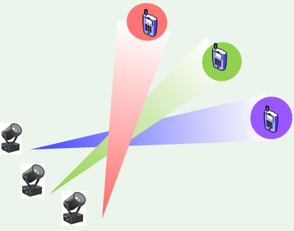
Joint Precoding for RIS-Aided Cell-Free Network
System model: The superposition of BS signals and RIS signals
RIS 1
RIS r
RIS R
b——BS id
k——user id
r—— RIS id
p——subcarrier id
. .
. .
BS 1
user 1
BS b
user k
Received signal on subcarrier p at user k
BS B
user K
RIS precoding
BS precoding
Notes:
First, let‘s take a look at the system model. For the traditional cell-free system, We can see that there are multiple base stations serving multiple users at the same time. Here, we use b for the base station id and k for the user id. For clarity, we only draw the channel from base station b to user k. In fact, the channels from each base station to each user all exist. At the same time, we consider that the subcarrier id is represented by p in wideband system. Then, we deploy multiple RIS(click mouse) in the scenario and represent the id of RIS with r. We assume that there are R RIS. We can think that each base station has a channel with each RIS, and each RIS has a channel with each user, so that each RIS can reflect the signals of all base stations to all users. What the user k receives is the superposition of the transmitted signals from multiple base stations (click the mouse). It is noted that the channel consists of two parts: the direct path from the base station to the user and the reflection path through the RIS. (click mouse) For theta and W in the formula, theta and W are precoding matrix and vector of RIS and base station, respectively. Based on this model, we can discuss many kinds of optimization problems.

Slide 9
Joint Precoding for RIS-Aided Cell-Free Network
Joint precoding: Sum-rate maximization
b——BS id
k——user id
r—— RIS id
p——subcarrier id
RIS precoding
SINR on subcarrier p at user k
BS precoding
Power constraint
Phase constraint
Notes:
Here we take a maximum sum rate problem as an example. Our optimization objective is to maximize the sum-rate of all users, and its expression is as shown above. The constraints of this optimization objective are the power of each base station (click mouse), and the reflection phase of each element on each RIS. Specifically, gamma represents the SINR (click mouse) of each user on each subcarrier. We optimize the problem and get a practical algorithm.

Slide 10
Joint precoding framework
Overview：
Lagrange dual
transformation
optimze
Fractional programming
optimze
optimze
Derivation
iteration
optimze
Fractional programming
Notes:
For the specific algorithm, we first perform Lagrange dual transformation operation on the objective function, and then get three optimization variables. We adopt the strategy of fixing two of them to optimize the other one, by simply solving the QCQP problem or derivation, and then through the iteration of three variables, finally, the objective function will converge to a local optimal solution.

Slide 11
Simulation Result
Simulation parameters
  2 BSs (each is equipped with 8 antennas)
  2 RISs (each is equipped with 32 elements)
  4 users
  6 subcarriers
Y
RIS 1
RIS 2
(30 m, 3 m)
(50 m, 3 m)
user 2
user 1
user 3
X
(0,0)
user 4
AP 1
AP 2
(0 m, -20 m)
(80 m, -20 m)
Notes:
Consider our simulation scenario. We consider a scenario of two base stations and four users and 2 RIS. Their deployment location is shown in this slide:
Among them, four users are randomly distributed in a circle with a radius of 2m, and the center of the circle is on the X axis. We hope to get the maximum sum-rate when the user moves on the X axis, and the user's motion is as shown in the slide (click the mouse). It can be predicted that when the user group is far away from the base station, the sum-rate will decrease, and when it is close to RIS, the sum-rate will increase.

Slide 12
Simulation Result
Sum-rate performance
Ideal RC
Continuous phase shifter
2-bit phase shifter
1-bit phase shifter
  RIS-aided
No RIS
The channel capacity of RIS-aided cell-free network increases significantly
[Zhang’19] Z. Zhang and L. Dai, “A joint precoding framework for wideband RIS-aided cell-free network,” submitted for publication, 2019.
Notes:
Suppose L represents the distance from the center of the circle to the origin, as shown in the figure is our simulation result. The X axis represents the distance from the center of the circle to the origin, and the Y axis represents the users’ sum-rate. We have given five simulation curves, including ideal RC, which is in the ideal condition when the phase and the amplitude of RIS elements can be continuously controlled, continuous phase shifter represents the RIS elements with continuous phase shifter, and 2bit and 1bit phase shifte are the discrete phase shifters. In particular, No RIS represents the simulation results when the two RIS are not deployed.
(click the mouse) first of all, notice that for the green curve, that is, without RIS, as the user group is far away from base station 1, the sum-rate decreases, and the sum-rate increases near base station 2. Then look at the other curves, (click the mouse), it is noted that there are two peaks near 30m and 50m due to the existence of RIS, which indicates that RIS does play a role in increasing the signal coverage, compared with the green curve, the gain is obvious. Through comparison, we can find that the users’ sum-rate is increased by RIS significantly, which shows that the cooperative of multiple base stations and multiple RIS does play a role in increasing the system capacity. Due to the low cost of RIS, there is no doubt that this result is of great significance.

Slide 13



IEEE SPAWC 2020
Reproducible Research: http://oa.ee.tsinghua.edu.cn/dailinglong/
Notes:
That’s all, thank you for your listening.

